Slide 1


Slide 2
Main Pillars
Science and Technology
Enemies are a protector race (hence Golem design)
Volatile and Broken Surface World
Consistent, Clean, Polished Spaceship
(Story) Exploring the morality of science

Slide 3
Main Mechanics
Shoot ‘em and Loot ‘em
Dungeon Delving
Diverse random loot
Bosses
Exploration incentivized through loot and story progression.

Slide 4
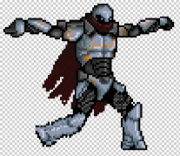
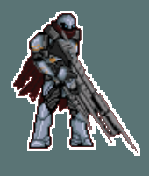
Our Protagonist
Meet “J”
He is one of science’s greatest wonders: an artificial intelligence that exceeds the physical capabilities of humans in every way
But, is he really the “perfect” human?

Slide 5
Story
It is the year 2653
You’re orbiting the planet of Vardus in the Cataian Galaxy.
An alien artifact - The Cube - lies broken on the surface of Vardus
You’re tasked with reassembling the cube
It promises great scientific advances
But, upon touching down on the planet’s surface you realize the locals are hostile.
When you first touch a piece of The Cube, you realize that it too holds a secret.

Slide 6
Final Feature Set
1 (large) dungeon, 4 dungeon bosses
Final boss
Random loot: most loot comes from exploring levels and killing bosses
Lore books scattered around the hub and world that provide backstory
Continuous progression curve (reduced death penalty)
Monsters get progressively more difficult as you descend the dungeon
Controller Support

